Slide 1
UKI – New Fields in Meeting Speaker Detail section
Criticality | Scope / Impact | Priority Rank
Operational Efficency | Few | 5
Requirements

Slide 2
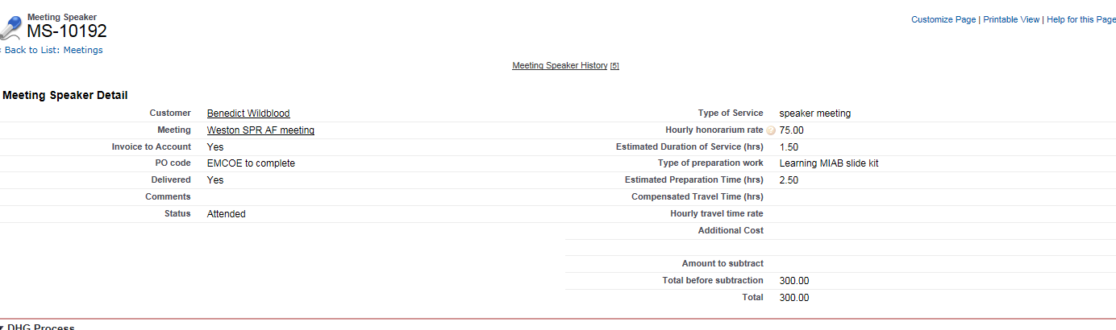
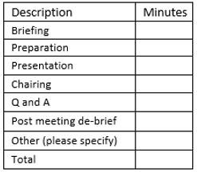
UKI – New Fields in Meeting Speaker Detail section
Request:
In the Meeting Speaker Detail section can we add additional fields, so reps can add the amount of minutes on the following break down list.
Example:

Slide 3
UKI – New Fields in Meeting Speaker Detail section
Business Rationale:
This change request supports the FFM Simplification process.
The EMCOE team will soon be in charge of generating the fee for service contract for the HCP to sign, the breakdown of what the HCP is getting paid for needs to be provided by the rep.
Currently this is done via email and it would be better to ensure that this is captured in InterAct in the Meeting Speaker Detail section.
This will reduce the effort required to gather this information and thereby simplifying the process.

Slide 4
UKI – New Fields in Meeting Speaker Solution 1 : Breakdown Section
New Honorarium Breakdown Section in the Meeting Speaker layout :
New Section Honorarium Breakdown will be added in the meeting Speaker layout :
Displayed and editable in Planning Phase (used to generate the Speaker Statement of Work)
Displayed Read-only in Post Execution
6 new fields populated by the rep with minutes spent for that type of activity and 2 new fields calculated
Briefing (mins) : filled by user in minutes
Preparation (mins) : formula based on already existing Preparation time and converted to minutes
Presentation (mins) : filled by user in minutes
Chairing (mins) : filled by user in minutes
Q and A (mins) : filled by user in minutes
Post meeting debrief (mins) : filled by user in minutes
Travel (mins) : formula based on already existing Travel time and converted to minutes
Other (mins) : filled by user in minutes
1 Total (hrs) formula field defined as the sum of the 8 detail Fields and converted to Hours. Number field with 2 decimals (15 min -> 0,25 Hrs)
Total (hrs) will be calculated by the sum of the 6 user filled fields above (converted to Hours) + Preparation Time + Travel Time
To avoid complex validation rules : Breakdown fields populated by the user will be mandatory. If service was not delivered or one of the fields is not relevant, user will have to enter « 0 »
Breakdown accuracy is the user’s responsibility, no control or validation rule

Slide 5
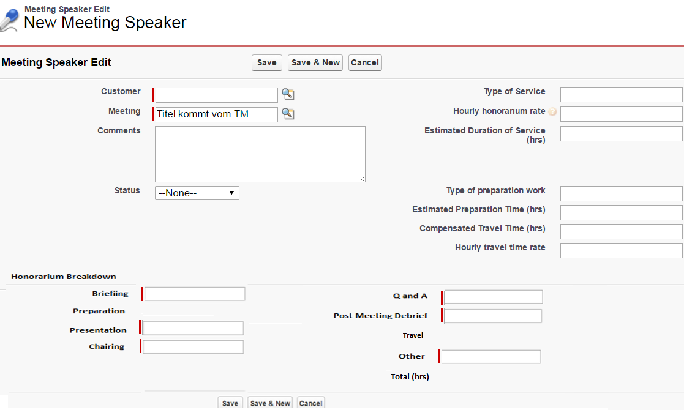
UKI – New Fields in Meeting Speaker Solution 1 Proposed Layout
Preparation, Travel and Total will be displayed and calcualted after clicking on Save

Slide 6
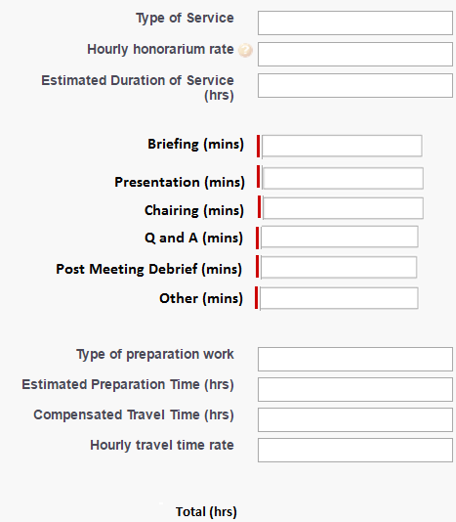
UKI – New Fields in Meeting Speaker Solution 2 : Breakdown in current section
Breakdown and Total fields will be added in the existing section of the Meeting Speaker layout.
All ther rules described in Solution 1 apply in Solution 2
New Breakdown fields will be after the Estimated duration of Service : the sum of all 6 fields should be equal to the duration of Service
Total Hours calculated at the bottom

